Slide 1
Effect Size
Parameter used to compare results of different studies on the same scale in which a common effect of interest (response variable) has been measured
Magnitude of effect
e.g. mean
Index of precision
e.g. variance, standard error, CI

Slide 2
Variance
Most common index of precision
Standardizes unlike things
Turns apples and oranges into juice

Slide 3
Common measures of effect size
Standardized mean difference
Hedges’ d
Log Response Ratio
Correlation
Pearson’s correlation
Others
Contingency tables,

Slide 4
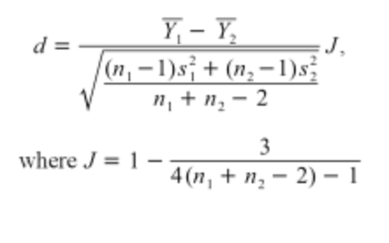
Mean Difference (Pairs of Means)
When to use it?
Quantify strength of treatment effect
Standardized difference in mean used to adjust for difference scales in different studies
VARIANCE, (n, std dev)
What is it?
Hedges’ d or g
Log Response Ratio
ln R = ln Y₁ – ln Y₂

Slide 5
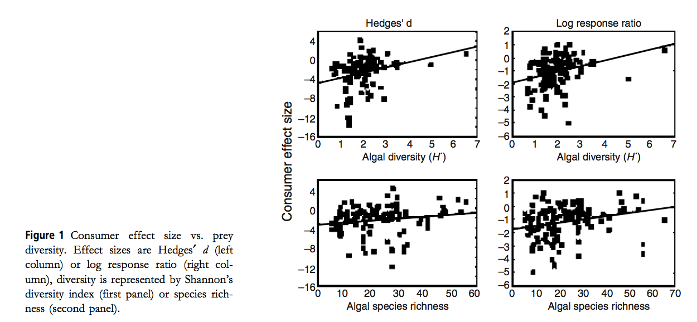
Mean difference
Hillebrand and Cardinale 2004 Eco Letters
Notes:
Effect of invert or vert consumers on periphyton biomass was characterized with 2 indices
A hedges d was used for the absolute effect of grazers on algal biomass as the standardized difference between mean algal biomass in ungrazed controls and grazed treatments
LRR was used for the relative effect of consumers as the ln transformed ratio of mean algal biomass in ungrazed controls relative to grazed treatments.
Increasingly negative values means greater fraction of algal biomass consumed

Slide 6
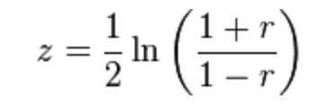
Correlations
When to use it?
Looking at association between two continuous variables (regressions!)
Variance not reported (Common!)
But Z-score, t test, F statistic, χ² can be transformed into correlation coefficients
What is it?
Pearson’s correlation (Fisher’s z-transformation)
Variance depends on sample size only!

Slide 7
Other Effect sizes
Two x Two Contingency data
When to use it?
Compares two groups with observed accounts of two outcomes (e.g. χ² table)
What is it?
Rate difference
Limited by magnitude of P
Rate ratio
Odds ratio

Slide 8
Other Effect sizes
Slopes from simple linear regressions

Slide 9
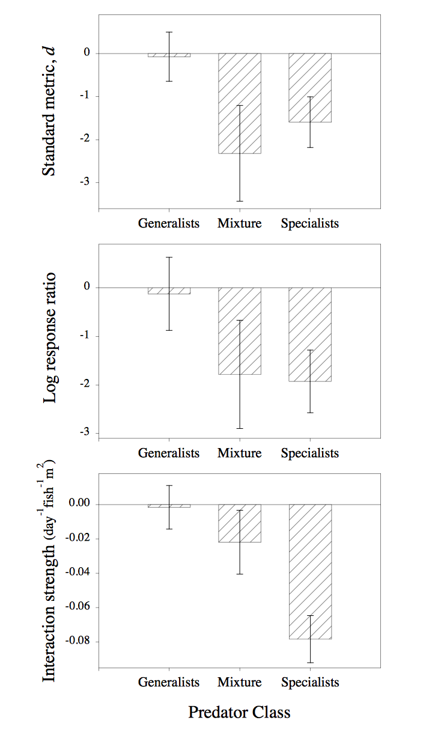
Alternative measures of effect size
Osenberg and St Mary 1998

Slide 10
Other metrics of effect size Don’t Panic!!
We have the power to calculate effect sizes under a variety of distributions
Normally distributed data
Count data
Proportions
Diversity
Shannon diversity variance can be calculated
Non Standard or Unknown distributions

Slide 11
Other metrics of effect size Corrected effect sizes
If covariates are known, can account for and adjust effect estimates
Pros?
Cons?
Both

Slide 12
Sensitivity analysis
What if things were different?
Distribution type
Adjust effect size?
Inflate variance to incorporate error?
Use n as variance?
Make sure that the effect isn't because of the effect estimate!

Slide 13
Conclusions
Why are there meta-analysis?
“The basic recipe is dangerously simple: extract estimates of the magnitude of effect (ei) and its variance (v(ei)) from each study, and use weighted statistical analyses (e.g., weight by 1/v(ei)) to estimate categorical means, or response surfaces, and their confidence limits.” Osenberg and St Mary 1998

